Slide 1
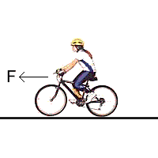
Friction & Applying Newton’s 2nd Law
System
Chapter 6.2

Slide 2
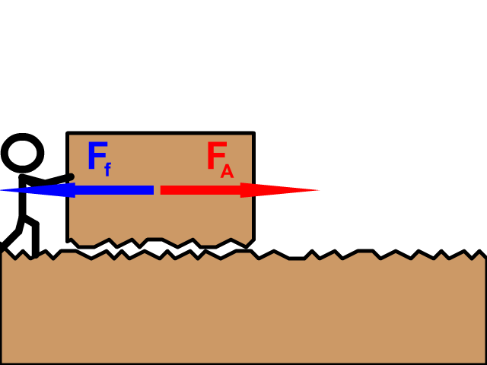
What is Friction?
Friction is a force that is parallel to the surfaces of two objects that are in contact with one another that resists the relative motion of the two objects.
Skin-Depth

Slide 3
What causes friction?
Friction is caused by the temporary electrostatic bonds created between two objects in contact with one another.

Slide 4
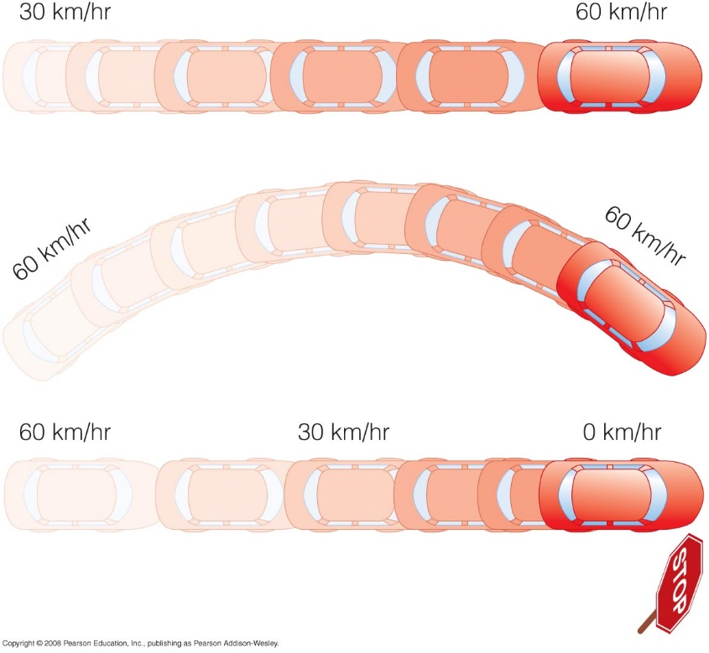
Friction
How does friction affect the motion of objects?
It can slow an object down
like the friction between
the tires and the road.
It is responsible for
increasing the speed of an
object like a car.
It is also responsible
for objects being able to
change direction.

Slide 5
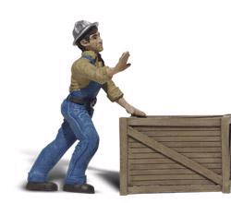
Static Friction (Stationary Objects)
Static Friction:
The resistive force that keeps an object from moving.
Since v = 0, a = 0, and equilibrium exists.
F_{ground-on-crate}
F_{friction}
F_{applied}
F_{net} = F_{applied} – F_{friction}
Since the crate is not accelerating, F_{net} = 0
F_{applied} = F_{friction}
F_{friction}
F_{applied}
System
F_{gravity}
Note: As long as the crate does not move, F_{applied} = F_{friction}

Slide 6
Kinetic Friction (Objects in Motion)
Kinetic Friction:
The resistive force that opposes the relative motion of two contacting surfaces that are moving past one another.
F_{net} may or may not be 0.
F_{ground-on-crate}
F_{friction}
F_{applied}
F_{net}
F_{friction}
F_{applied}
F_{net} = F_{applied} – F_{friction}
Note: If the crate moves at a constant velocity, then F_{applied} = F_{friction} and F_{net} = 0.
System
F_{gravity}

Slide 7
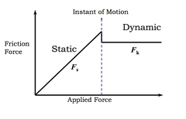
Comparing Static Friction to Kinetic Friction
Disequilibrium
$$F_{net}≠0$$
Equilibrium
$$F_{net}=0$$
Disequilibrium
$$F_{net}≠0$$
$$F_{f}=F_{A}$$
$$F_{A}>F_{f}$$
F_{N}
When object begins to move, $F_{A}>F_{f}$
F_{f}
F_{A}
F_{g}
$$F_{fmax(static)}>F_{f(kinetic)}$$

Slide 8
Determining the Frictional Force (The Coefficient of Friction, μ)
The force of friction (F_{f}) is proportional to the normal force (F_{N}) and a proportionality constant (μ - pronounced mu) called the coefficient of friction.
As per the formula, the greater μ, the greater the frictional force.
Alternatively, the greater the normal force, the greater the frictional force.
Note: F_{N} = the force normal (perpendicular) to the frictional force on the object.
μ is dimensionless (NO UNITS)
F_{N}
F_{A}
F_{f}
F_{g}
Frictional Force
Slope = µ
Normal Force

Slide 9
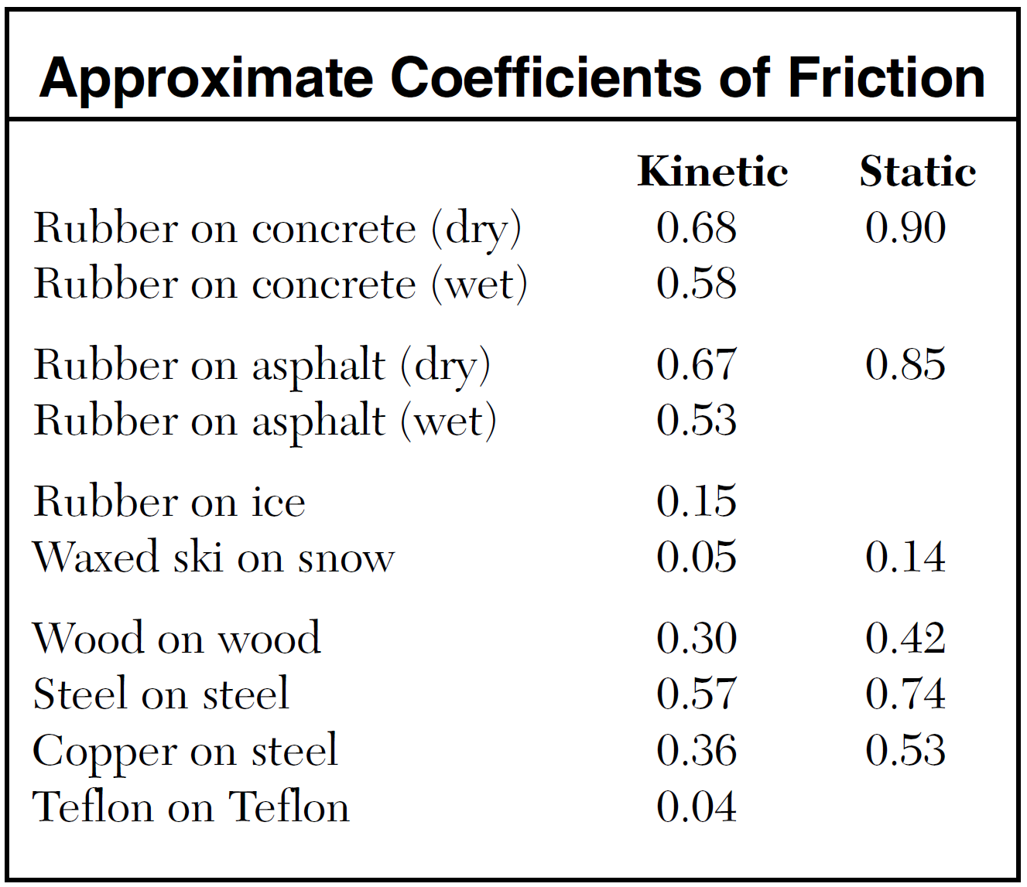
Coefficients of Friction and the Reference Table
$$μ_{(static)}>μ_{(kinetic)}$$

Slide 10
The Normal Force
The normal force is a force that most often opposes the Earth’s gravitational attraction and is perpendicular to the surface that an object rests or is moving on.
For a horizontal surface, F_{N} = F_{g} = mg.
For a surface that is not horizontal, as seen in the figure below, F_{N} = F_{g}cosθ
F_{N}
θ

Slide 11
The Normal Force
$$FN = Fg cos = mg cos$$
F_{N}
y
F_{N}
x
$$cosθ =\frac{adj}{hyp}=\frac{F_{g⊥}}{F_{g}}$$
θ
$$F_{g⊥}=F_{g}\cos{θ}$$
F_{g}
$$sinθ =\frac{opp}{hyp}=\frac{F_{g∥}}{F_{g}}$$
F_{N} = F_{g} = mg
F_{g}
$$F_{g∥}=F_{g}\sin{θ}$$
On an incline plane, break the weight vector into two components; one that acts parallel to the incline plane and one that acts perpendicular to it.
The component perpendicular to the incline plane is equal to the normal force.

Slide 12
Example 1: Determining the Normal Force and the Force Parallel to the Incline
A 10.-kg crate is resting on an incline at 30. degrees above the horizontal.
Determine the net force acting on the crate.
Determine the normal force.
Determine the component of gravity acting along the incline.
Determine the frictional force.
F_{N}
$$=30∘$$

Slide 13
Ex. 1: (cont.)
Since the crate is at rest, the object must be in equilibrium. F_{net} = 0.
Normal force equals the component of gravity perpendicular to the incline.
$${F_{N}=F}_{g⊥}=F_{g}\cos{θ}=mg\cos{θ}$$
$$F_{N}=(10kg)(9.81\frac{m}{s^{2}})(\cos{30°)}$$
$$F_{N}=85N$$
Component of gravity parallel to the incline.
$$F_{g∥}=F_{g}\sin{θ}=mg\sin{θ}$$
$$F_{g∥}=(10kg)(9.81\frac{m}{s^{2}})(\sin{30°)}$$
$$F_{g∥}=49N$$
Since the crate is at rest, the forces along the incline are balanced.
$${F_{net}=F_{f}−F}_{g∥}=0$$
$$F_{f}=F_{g∥}=49N$$
F_{N}
$$=30°$$
$$F_{g⊥}=F_{g}\cos{θ}$$
F_{g}
$$F_{g∥}=F_{g}\sin{θ}$$

Slide 14
Example 2: Determining Friction (Balanced Forces)
Assume that the man in the figure is pushing a 25 kg wooden crate across a wooden floor at a constant speed of 1 m/s.
How much force is exerted on the crate?
F_{N}
F_{f}
F_{applied}
System
F_{g}

Slide 15
Diagram the Problem
+y
F_{N}
F_{N}
F_{f}
F_{applied}
F_{f}
F_{applied}
System
F_{g}
F_{g}
+x
y-direction: F_{N} = F_{g}
x-direction: F_{net} = F_{applied} - F_{f}
Since the crate is moving with constant speed,
a = 0, F_{net} = 0, and F_{applied} = F_{f}

Slide 16
State the Known and Unknowns
What is known?
Mass (m) = 25 kg
Speed = 1 m/s
Acceleration (a) = 0 m/s²
μ_{k} = 0.3 (wood on wood from reference table)
What is not known?
F_{applied} = ?

Slide 17
Perform Calculations
y-direction:
$Fg=F_{N}=mg$ (Note: horizontal surface)
x-direction: Since a = 0, F_{net} = 0
$Fnet=Fapplied –F_{f}$
$Fapplied=F_{f}$
$Fapplied =kFN$ $Fapplied=kmg$
$Fapplied=(0.3)(25 kg)(9.8 m/s2)$
$Fapplied=73.5 N$
0

Slide 18
Example 3: Determining Friction (Unbalanced Forces)
Assume that the man in the figure is pushing a 25 kg wooden crate across a wooden floor at a speed of 1 m/s with a force of 73.5 N.
If he doubled the force on the crate, what would the acceleration be?
F_{N}
F_{f}
F_{applied}
System
F_{g}

Slide 19
Diagram the Problem
+y
F_{N}
F_{N}
F_{f}
F_{applied}
F_{f}
F_{applied}
System
F_{g}
F_{g}
+x
y-direction: F_{N} = F_{g}
x-direction: Since a > 0, F_{net} = F_{applied} - F_{f}

Slide 20
State the Known and Unknowns
What is known?
Force = 147 N
Mass (m) = 25 kg
Speed = 1 m/s
μ_{k} = 0.3 (wood on wood)
What is not known?
a ?

Slide 21
Perform Calculations
y-direction:
$Fg=F_{N}=mg$ (Note: horizontal surface)
x-direction: Since a = 0, F_{net} = 0
$Fnet= Fapplied –Ff$
$ma= Fapplied –Ff$
$a= \frac{Fapplied –Ff}{m}$
$a= \frac{147N –73.5N}{25kg}$
$a=2.9\frac{m}{s^{2}}$

Slide 22
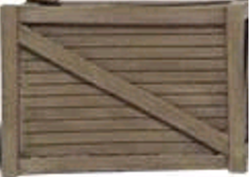
Example 4: Acceleration and Distance (Unbalanced Forces)
Assume that the man in the figure is pushing a 25.0 kg wooden crate across a wooden floor at a constant speed of 5.00 m/s when he suddenly stops pushing on it.
What is the net force immediately after he stops pushing on the crate?
What is the acceleration of the crate?
How far does it travel before coming to a stop?
F_{N}
F_{N}
F_{f}
F_{applied}
F_{f}
F_{g}
F_{g}

Slide 23
Diagram the Problem
+y
F_{N}
F_{N}
F_{f}
F_{applied}
F_{f}
F_{g}
F_{g}
+x
y-direction: F_{N} = F_{g}
x-direction: Since a > 0, F_{net} = - F_{f}

Slide 24
State the Known and Unknowns
What is known?
Mass (m) = 25 kg
Speed = 5 m/s
μ_{k} = 0.3 (wood on wood)
What is not known?
Force = ?
a = ?
d = ?

Slide 25
Perform Calculations
y-direction:
$Fg=F_{N}=mg$
x-direction: a is negative
$Fnet= –F_{f}= –73.5N$
$ma= –Ff$
$a= \frac{–73.5N }{25kg}$
$a = −2.9 m/s2$

Slide 26
Perform Calculations
x-direction: How far does it slide?
Use kinematics equation.
$v_{f}^{2}=v_{i}^{2}−2ad$
$d=\frac{v_{i}^{2}}{2a}$
$d=\frac{{(5.00\frac{m}{s})}^{2}}{(2)(2.94\frac{m}{s^{2}})}$
$d=4.25m$
0

Slide 27
Key Ideas
Friction is an opposing force that exists between two bodies.
Friction is proportional to the normal force and the coefficient of friction; static or kinetic.
The force required to overcome static friction is greater than that required to overcome kinetic friction.

